Slide 1
Battle of Neighbourhoods
Coursera Capstone project by Manoj babu Paramadayalan

Slide 2
Introduction
I currently live in Melbourne and I have been offered a great opportunity to work for a leading Finance firm in Canberra. I am very excited and I want to use this opportunity to practice my learnings in Coursera in order to answer my key question, finding out an affordable and enjoyable place similar to mine now in Melbourne.
In order to make a comparison and evaluation of the rental options in Canberra, I must set some basis, therefore the apartment in Canberra must meet the following demands:
Apartment Size : 2-3 bedroom unit
Location : Close to public commute stations
Rent: Not more than 800 per week
Others: amenities in the selected neighbourhood shall be similar to current residence

Slide 3
Data Required
List of Boroughs and neighbourhoods of Canberra with their geodata (latitude and longitude)
List of bus stations in Canberra with their address location
List of apartments for rent in Canberra with their addresses, no.of beds and weekly rent
Venues for each Canberra neighbourhood
Venues near my location in Melbourne

Slide 4
Data acquisition and cleaning
Rental prices data has been collected using webpage scraping and manual data collection from rental websites.
The Geodata for rental prices dataset has been acquired using Nominatin
The key dataset of Canberra (Neighbourhood, Postcode with latitude & longitude data) has been downloaded Australia Post Website.
The bus station dataset (Stop Name, Neighbourhood, Postcode with latitude & longitude data) has been downloaded from data.gov.au

Slide 5
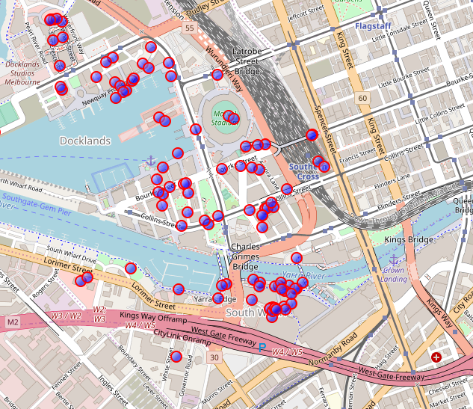
Exploratory Data Analysis
Venues around current Neighbourhood

Slide 6
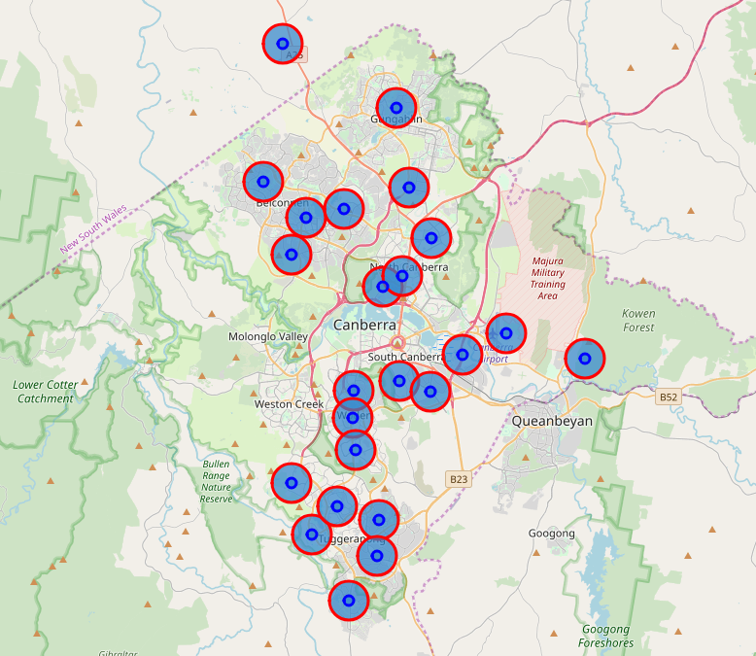
Canberra Neighbourhood Map with Cluster of Venues
Using KNN Algorithm, we were able to cluster the venues in Canberra so that we can compare and Analyse the rental places and bus stations nearby in the next steps.

Slide 7
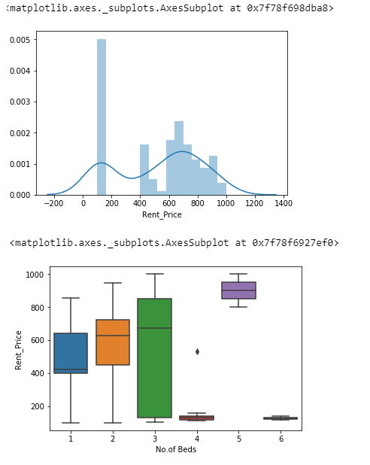
Statistical analysis of Canberra Rental Prices

Slide 8
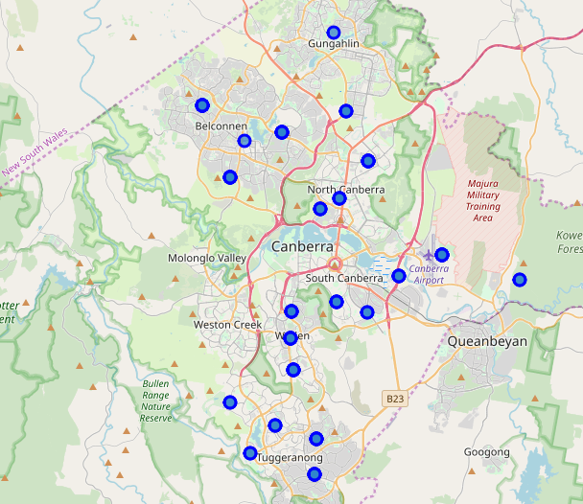
Map of Canberra with rental places

Slide 9
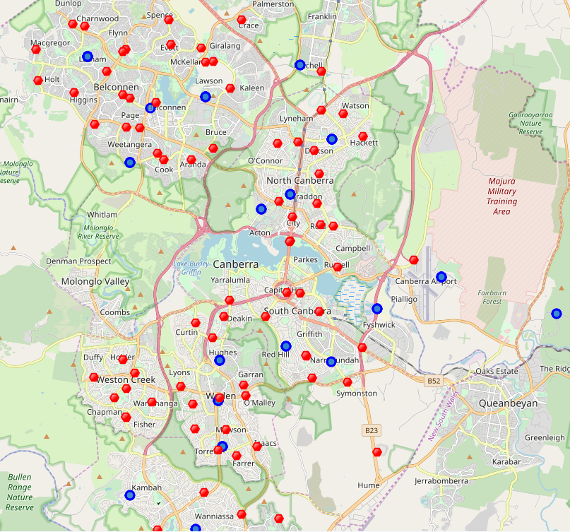
Map of Canberra
Bus stations - red dots
Rental places - blue dots

Slide 10
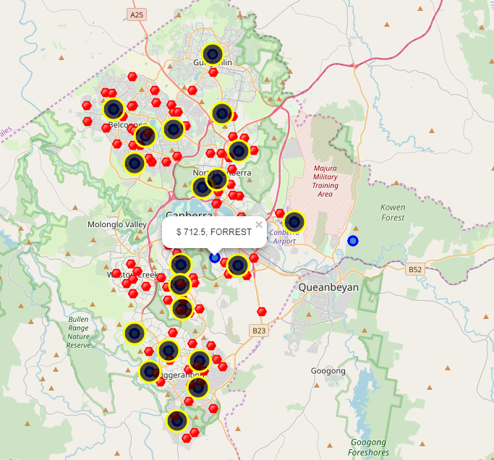
Result Section
In this section all the required information to make the apartment selection is consolidated in one map. The Map of Canberra with rental places, but station locations and cluster of venues.
Red dots are bus stations, Blue dots are apartments available for rent, Bubbles are the clusters of venues
After examining, I was able to choose one location that meet the desired requirements.
Apartment 1: Forrest Neighbourhood and it is near 'LA PEROUSE ST AFTER CALEY CR' bus station, Cluster # 1 Monthly rent : 712.5 AUD

Slide 11
Discussion & Conclusion
In this study, I analysed the relationship between Venues, commute stations and House rents. I identified that different type of venues and nearby commute stations play an important role for house/apartment rental prices in that Neighbourhood. I built Maps with markers each for venues, bus stations and rental places to compare and find the right place like my current place. These maps can be very useful in helping anyone to explore and decide a right place to move in into Canberra.
This project has shown me a practical application to resolve a real-world scenario using Data Science tools and methodologies. The mapping with Folium is a very powerful technique to consolidate information and make the analysis and decision thoroughly and with confidence.

